Slide 1
Artificial Intelligence Training

Slide 2
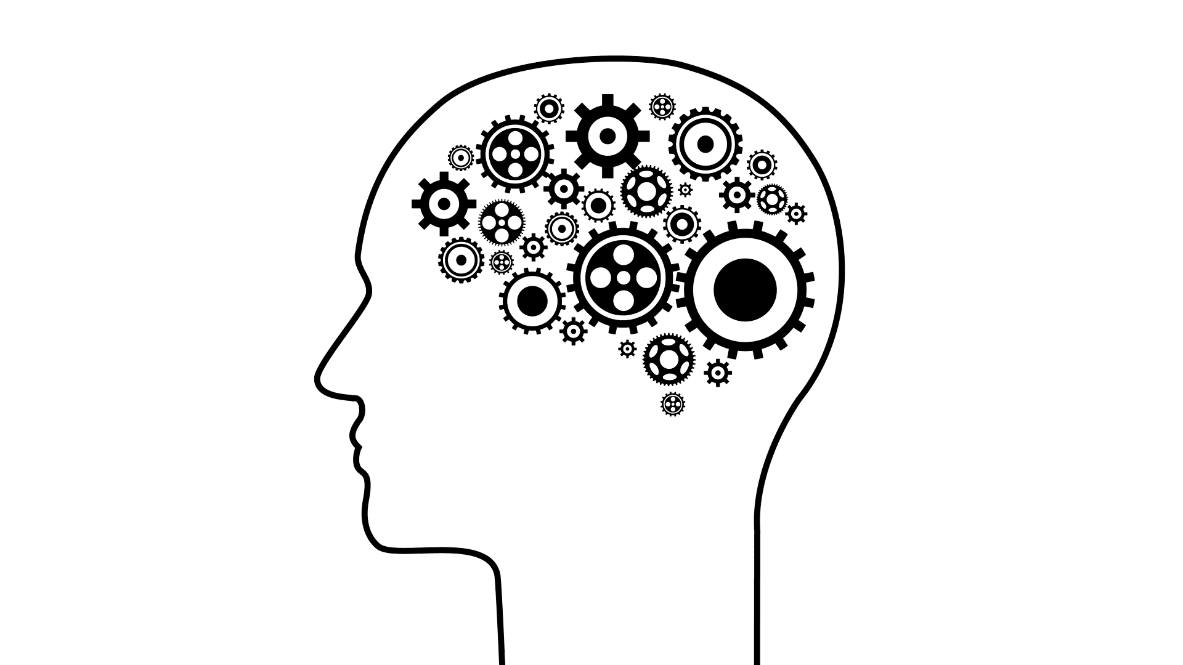
Today we will learn:
Today we will learn about machine learning models:
How they work
How to evaluate their performance
How we might test and assure them
Notes:
Start with creds,
What this training isn’t
I like to be interrupted

Slide 3
What should I be doing?
Start work on the notebook
Complete Part Zero of the notebook:
Including the “Calculate percentage function”
Then come back to the call and like the comment in chat.
If you have any issues do speak up!

Slide 4
Part 1 A Brief Introduction to Predictive Models

Slide 5
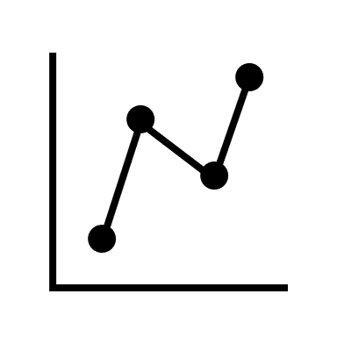
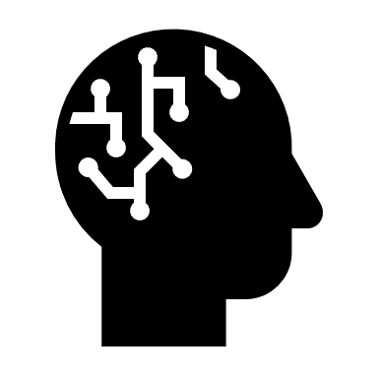



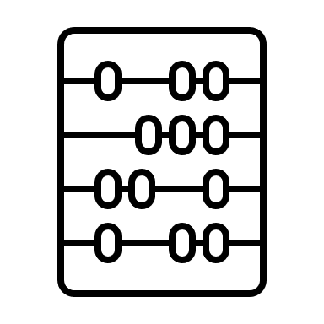

What is Machine Learning?
We take data from the past.
A Machine Learning Algorithm will process the data.
It can find trends and make predictions.
Simply, Machine Learning uses computers and data to solve problems.
Notes:
What is a machine learning algorithm? Maybe mention that on the slide before. What are the problems we are trying to solve?
Mention difference between this and traditional coding
Generally we use machine learning when problems would be too expensive to be solved by other methods

Slide 6
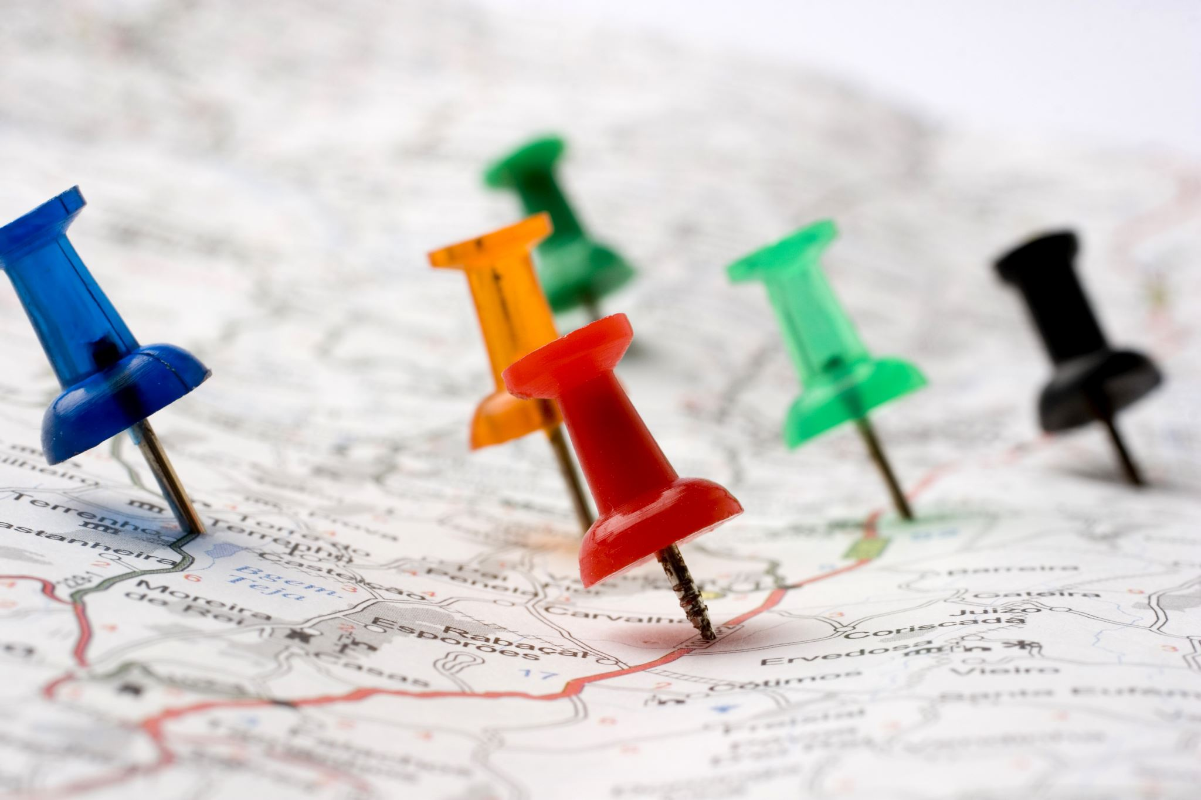
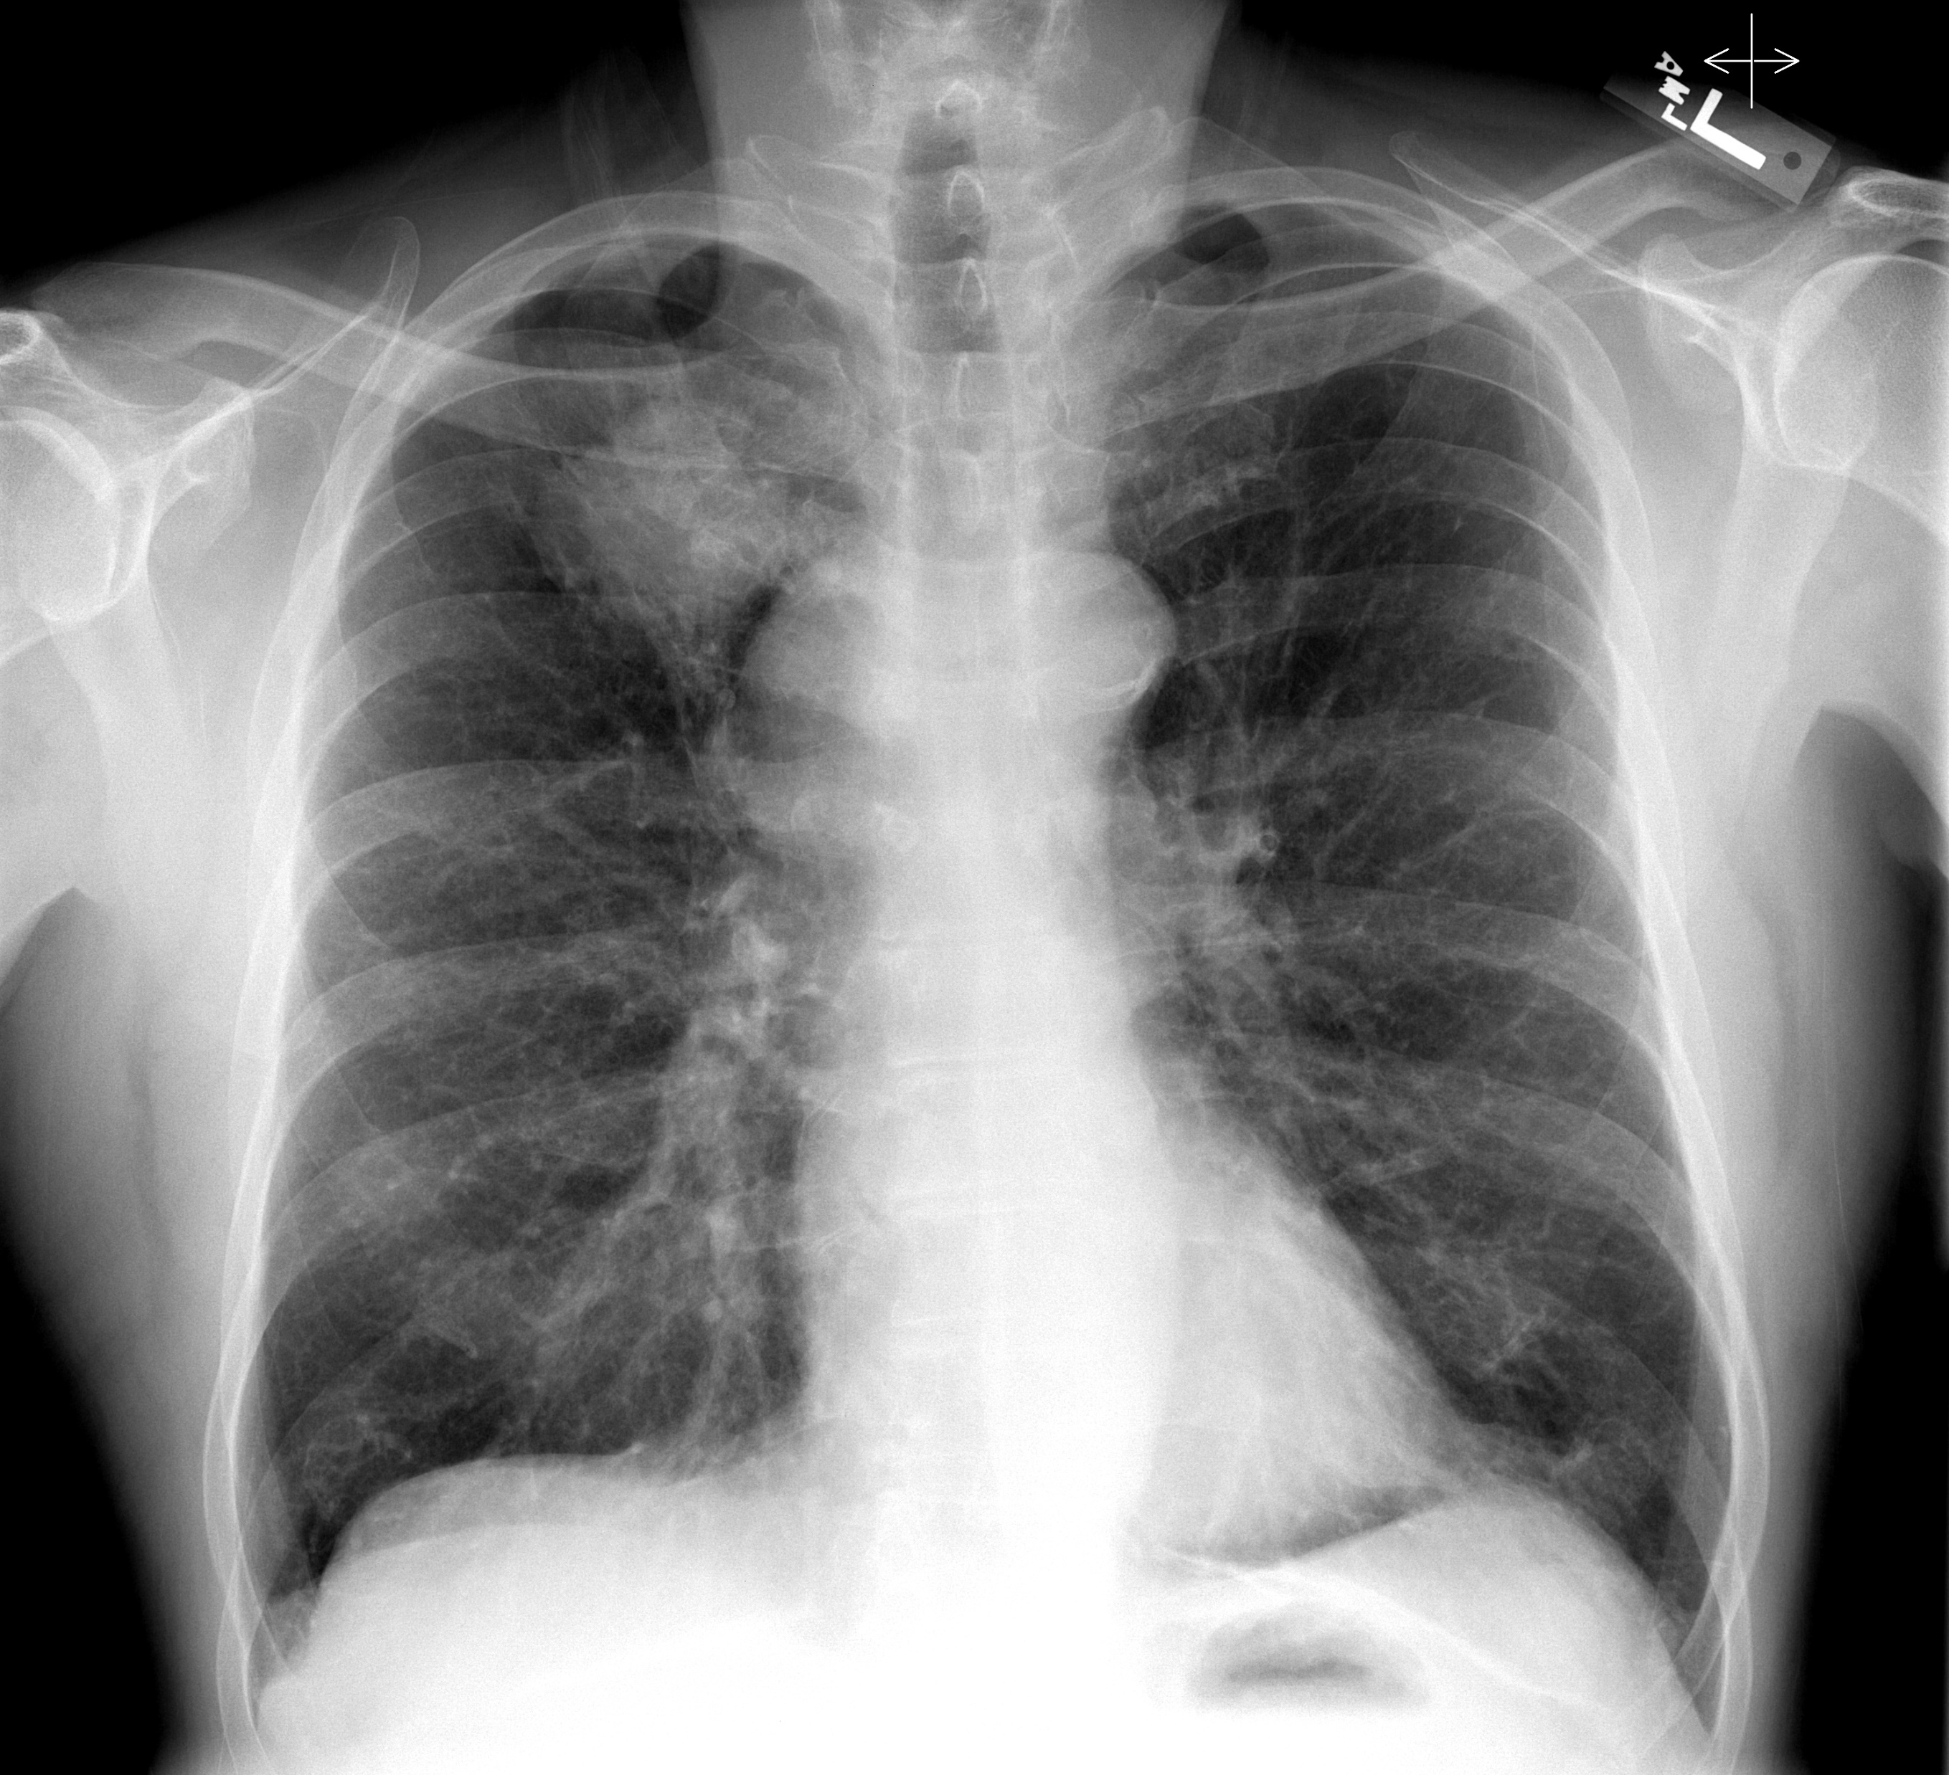
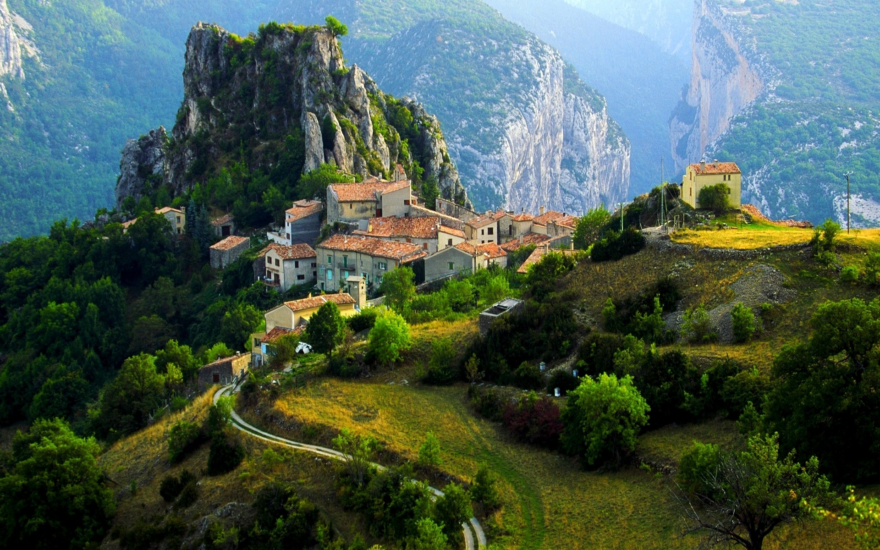
What Problems can Machine Learning Solve?
Can I group together similar local authorities based on statistics from each authority?
Based on past data, can I tell if someone has lung cancer from an X-ray of their chest?
Based on past data, how much rainfall will a new housing estate receive if I build it at an altitude of 1300m?
Notes:
Maybe too much on the slide, split up.
What is a machine learning algorithm? Maybe mention that on the slide before. What are the problems we are trying to solve?

Slide 7
What should I be doing?
Complete Part 1 of the notebook.
By the end you should be able to produce 2D and 3D scatter plots of the data.
Then come back to the call and like the comment in chat.
If you finish: Try different combinations of column names, which ones separate the data the most?
If you have any issues do speak up!

Slide 8
Part 2 Types of Predictive Models
Notes:
We have only looked at a few dimensions, we want to be able to ‘look’ at lots more.
The following slides might get a little difficult, and a little technical for a lot of you. And at times you might wonder why you, working in solutions assurance, need to know all these new terms and learn about all these new concepts?
The key thing is: In the future, when working with developers and stakeholders who have these new AI systems, there are a lot of terms and concepts you’ll need to have a base understanding of to engage with these developers. Even if you don’t understand everything and forget some of the key terms, you’ll have something to turn to in the future, and you’ll hopefully know which terms you need to google!

Slide 9
Different Problems need Different Algorithms
This value is in the benign group
Classification Algorithm
Benign
Based on past data, can I tell if someone has lung cancer from an X-ray of their chest?
Classification Algorithms are used when you have labelled data.
Using algorithms with labelled data is often called Supervised Learning.
The majority of AI uses supervised learning.
Density
Malignant
Diameter
Classification Algorithms spot trends and patterns in the data.
In this data, 2 different groups are clearly labelled.
We want to predict what group a point is in.
This allows them to make predictions for new data points. E.g.

Slide 10
Different Problems need Different Algorithms
Regression Algorithm
This point will get X mm of rainfall!
Regression Algorithms are also used when you have labelled data - Supervised Learning.
Rainfall (mm)
Regression Algorithms also spot trends and patterns in the data.
Based on past data, how much rainfall will a new housing estate receive if I build it at an altitude of 1300m?
Altitude (m)
Again, this allows them to make predictions for new data points. E.g.
Continuous Values
We want to predict the rainfall of a point from its altitude.
Notes:
Triangles are new

Slide 11
Different Problems need Different Algorithms
Clustering Algorithm
Can I group together similar local authorities based on statistics from each authority?
Clustering Algorithms are used when you do not have labelled data.
Using algorithms with unlabelled data is often called Unsupervised Learning.
This is less common in AI used today
Population Density
Retail Floorspace
Algorithms are able to spot trends and patterns in the data.
2 different groups are not labelled.
We want to put the data into groups.
This allows them to put the data into ‘clusters’.
Notes:
Clustering algorithms are evaluated by separation
ANY QUESTIONS
Are we happy with
Supervised vs unsupervised
Classification vs regression vs clustering

Slide 12
How do Classification Algorithms work?
There are multiple different types of Classification Algorithms
Group 1
All algorithms go through a training stage.
They do not ‘see’ groups in a graph like us, but rather ‘guess’ if there are patterns and trends in the training data, and are rewarded for good guesses.
Y Values
Group 2
Algorithm 1 might find a good guess is that Group 1 lies in a rectangle. All other values are group 2.
Algorithm 2 may guess that a line divides the data points into 2.
X Values
Whatever method the algorithm does this by, it does so by training itself on the training data.
Different algorithms can give different predictions, let us say we want to predict the value of some new test data:
Algorithm 1 would predict the value to be in Group 2, whilst Algorithm 2 would predict the value to be in group 1.
Notes:
Rewarded by making good guesses. Pattern’s start to appear.

Slide 13
How do Regression Algorithms work?
Like classification, there are multiple different types of Regression Algorithms, each of them work in different ways.
Again, there are similarities!
All regression algorithms go through a training stage.
They do not ‘see’ trends in a graph like us, but rather ‘guess’ if there are patterns and trends in the training data, and are rewarded for good guesses.
Rainfall (mm)
Algorithm 1 might guess a straight line predicts the trend of the data.
Algorithm 2 may guess a curved line predicts the trend of the data.
Altitude (m)
Whatever method the algorithm does this by, it does so by training itself on the training data.
Different algorithms can give different predictions, let us say we want to predict the rainfall value of: given a certain altitude.
Algorithm 1 will predict higher rainfall than algorithm 2.
Notes:
Difference between classification and regression, line to fit vs line to separate,
Possibly look at overfitting in this example.
ANY QUESTIONS

Slide 14
How do we know if our fit is a ‘good guess’?
We are going to go through the training steps of a particular type of regression model, using our rainfall and altitude dataset.
This model:
Makes a guess to fit the trend.
Uses a loss function to see how good its guess is.
Tries to make a better guess.
Repeats.
Rainfall (mm)
A loss function simply measures the difference between predicted values and actual values.
Altitude (m)

Slide 15
First, what is a loss function?
A simple loss function could be to work out the difference in the number of points above and below the dashed line.
The closer the difference to 0, the better the prediction likely is.
Currently, there are 7 points above the line and 4 below, resulting in a difference of 3.
If we change the angle of the line, we get 6 points above, and 5 points below, this gives a difference of 1 - a much better prediction!
Rainfall (mm)
However, this is not a good loss function! Here, we can see the prediction is clearly very wrong, but the difference is still 1!
A better loss function is the squared error loss.
Altitude (m)
This takes the difference between each point and it’s predicted value, squares the value, and adds all the squared values together.

Slide 16
Lets train our model!
Difference between the predicted value and actual value.
Let’s make guess number 1.
Let’s draw in the residuals.
Get the values.
Work out the loss function value using squared error loss.
${19}^{2}+{13}^{2}+$ $8^{2}+$ $2^{2}+$ $7^{2}+$ $4^{2}+$ $8^{2}+$ $8^{2}+$ $9^{2}+$ $9^{2}+$ ${16}^{2}=1209$
8
16
4
8
9
Rainfall (mm)
2
9
8
7
19
13
Altitude (m)

Slide 17
Lets train our model!
Difference between the predicted value and actual value.
Let’s make guess number 1.
Let’s draw in the residuals.
Get the values.
Work out the loss function value using squared error loss.
${19}^{2}+{13}^{2}+$ $8^{2}+$ $2^{2}+$ $7^{2}+$ $4^{2}+$ $8^{2}+$ $8^{2}+$ $9^{2}+$ $9^{2}+$ ${16}^{2}=1209$
Let’s make guess number 2.
Rainfall (mm)
This time the loss is only about 500.
Altitude (m)

Slide 18
Lets train our model!
Difference between the predicted value and actual value.
Let’s make guess number 1.
Let’s draw in the residuals.
Get the values.
Work out the loss function value using squared error loss.
${19}^{2}+{13}^{2}+$ $8^{2}+$ $2^{2}+$ $7^{2}+$ $4^{2}+$ $8^{2}+$ $8^{2}+$ $9^{2}+$ $9^{2}+$ ${16}^{2}=1209$
Let’s make guess number 2.
Rainfall (mm)
This time the loss is only about 500.
Let’s make guess number 3.
This time the loss is about 300, and the curve looks like a good fit!
Altitude (m)

Slide 19
Let’s train our model!
Difference between the predicted value and actual value.
Let’s make guess number 1.
Let’s draw in the residuals.
Get the values.
Work out the loss function value using squared error loss.
${19}^{2}+{13}^{2}+$ $8^{2}+$ $2^{2}+$ $7^{2}+$ $4^{2}+$ $8^{2}+$ $8^{2}+$ $9^{2}+$ $9^{2}+$ ${16}^{2}=1209$
Let’s make guess number 2.
Rainfall (mm)
This time the loss is only about 500.
Let’s make guess number 3.
This time the loss is about 300, and the curve looks like a good fit!
Altitude (m)
Let’s make guess number 4.
The loss is about 100, and the curve looks to fit the data perfectly, without overfitting!

Slide 20
Wait, what’s overfitting?
Our model might not know when to stop, and will keep generating new curves to fit the training data.
The model has managed to find a mathematical equation that has reduced our loss function to essentially 0.
But, it has overfitted the data.
Rainfall (mm)
Whilst it fits the training data perfectly, when it comes to making new predictions, it can get them very wrong.
At this altitude, is predicted an uncharacteristically low rainfall for it’s altitude.
Altitude (m)
Notes:
The model is perfect on the training data, but would perform badly on data it hadn’t seen before.

Slide 21
What should I be doing?
Complete Part 2 of the notebook.
By the end you should be able to produce a trained Machine Learning model and use it to make a prediction!
Then come back to the call and like the comment in chat.
There are some questions to help you think about the topics in the notebook.
If you finish: Find a patient where the model is making an incorrect prediction.
If you have any issues do speak up!

Slide 22
Part 3 Testing of Predictive Models

Slide 23
How does a Data Scientist test their model?
Not to be confused with assurance test data!
Test data is part of the original dataset.
Data Scientists will test their model using test data.
Very simply, they will pass the labelled test data into the model, and compare the predicted values against the actual labels. Sometimes the labels of the test data are known as the ground truth.
The most simple measurement is a percentage measurement of how many guesses were correct – this is called Test Accuracy.
More advanced metrics include Confusion Matrices and F1 scores.
Notes:
Test data is part of original data, not to be confused with assurance data.

Slide 24
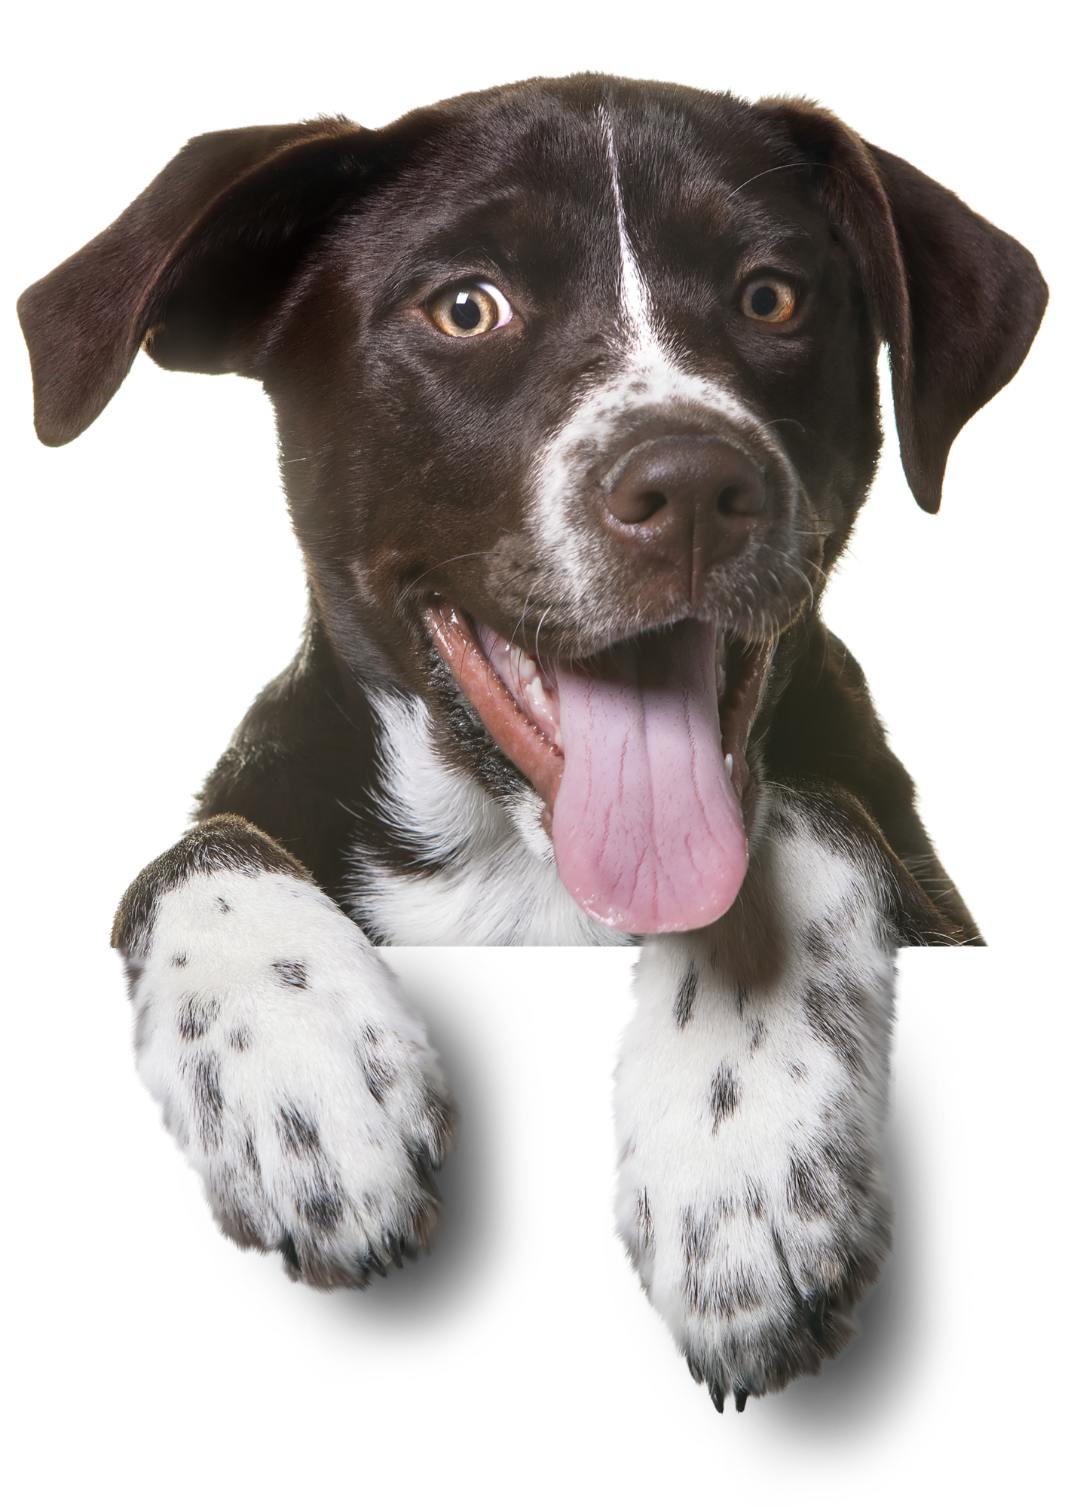
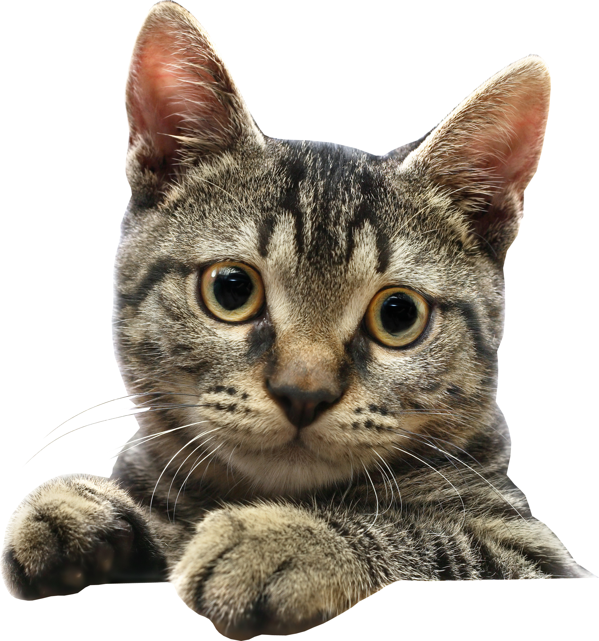
Precision and Recall
This is our little corner of the internet, containing dog photos and cat photos.
We also have a search engine, which can move around the internet. Anything within the search engine is returned to the user.
A little corner of the Internet…
Let’s start with a search for “dog photos”
Precision is a measure of how many returned photos are actually dog photos.
Recall is the percentage of dog photos that are correctly returned by the search bar.
Dog Photos
Cat Photos
Our first search returns low precision but high recall. All the dog photos on the internet are returned, but there are some cat photos too!
Our second search returns high precision and low recall. Not all of the dog photos are returned, but all of the photos returned are dog photos!
What would the following searches be? (the search is still for dog photos?
Notes:
Answers: 1) High precision and high recall 2) High recall but low precision

Slide 25
Precision and Recall
But how does this work for other types of AI, let’s say a cancer diagnosis classification model.
To the left is a set of test data for a cancer detection AI.
Breast Cancer Tumours
You can have different precision and recall scores for each class, i.e. malignant and benign. Consider this like doing a search for “malignant” and “benign” in our previous example.
Key
Malignant
Benign
Model 1 gives the following line. For the ‘malignant’ class it has high precision but low recall. Can you answer for the ‘benign’ class:
Does this show high or low precision?
Does this show high or low recall?
Mean Diameter (mm)
Malignant
Malignant
Model 2 gives the following line. For the ‘benign’ class:
Does this show high or low precision?
Does this show high or low recall?
Benign
Benign
Imagine you are a clinician using one of these models. Would you rather have:
High precision and low recall
High recall and low precision
Growth Rate (mm/d)
Notes:
Answers:
High recall, low precision
High precision, lower recall
High recall for malignant class, can sacrifice some precision.

Slide 26
What should I be doing?
Complete Part 3 of the notebook.
By the end you should be able to do some basic tests on a trained Machine Learning model.
Then come back to the call and like the comment in chat.
If you finish:
Follow the instructions in the optional section of Part 3.
Challenging! Create and test your own model.
If you have any issues do speak up!

Slide 27
Part 4 Assurance for AI Models

Slide 28
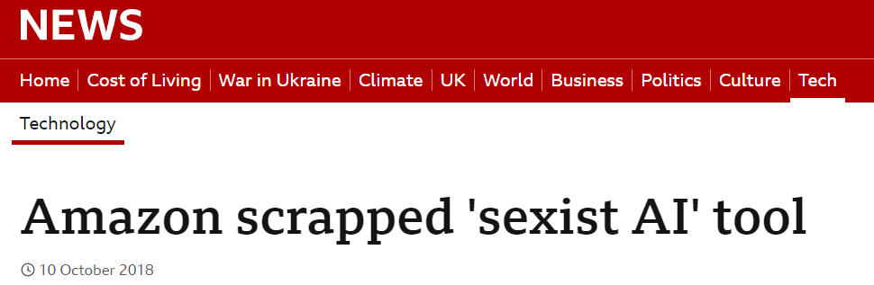
Interrogating Training Data
Countless examples like the above.
An AI system trained to review job applicants showed a bias towards male candidates.
It was trained on data submitted by applicants over a 10-year period, most of which were men.
Volume / Quality
If there is not enough good training data, then models can be very volatile.
Source / Context
If the training data has come from a particular source, it may not perform well in a different context.
Representation / Sampling:
A model trained mainly on one type of person may perform worse on others.
Proxys:
Model's training data may contain variables with similar patterns and trends to unwanted variables.
Consider a breast cancer classification model, trained with a dataset containing the postcode of patient’s GP practice.
It makes predictions partially based on the postcode, which can discriminate against certain backgrounds, such as age and ethnicity.
Can anyone think of a common proxy column?
Notes:
Machine learning models rely on the statistical relationship between the data and the target variable. The qualities of the model are related to the qualities of the data.
There are questions we can ask of the training data to identify risks.
NEWS EXAMPLE:
Model wanted to be given say 300 CVs, and only return the top 10 for a particular role.
PROXY EXAMPLE:
Consider an elderly lady who has gone to get a breast cancer screening, who’s usual GP is dominated by young university students. The model has learnt that patients from this GP are very unlikely to have breast cancer. It doesn’t know this because of the young demographic, it has simply made a link to the postcode. It might be the case that an elderly individual is more likely to be given a false negative prediction, simply because of the GP she goes to.
No clinical reason, don’t have it in your model.

Slide 29

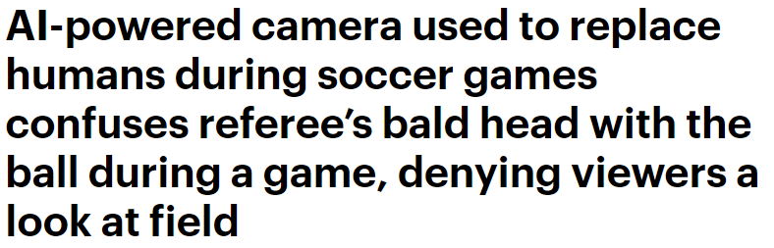
Interrogating Tests
With big data, 99% accurate can still leave thousands of people misclassified.
If a model is 99% accurate, but is searching for a rare disease that effects 1 in 10 million people, it could misclassify 100,000 people, and easily miss an important rare disease.
Interrogating Accuracy
99% test accuracy is sometimes not good enough.
Representation
Needs to represent real life, but also cover all expected scenarios.
Minority Classes may need to be oversampled.
Data leakage (Cheating!)
Unusually high test accuracy could indicate that the model is being given information that it wouldn't normally have in a true to life scenario.
Label noise
This is where your ground truth is either ambiguous or incorrect.
In medical imaging, different experts might disagree on the diagnosis of the same image.
Can anyone think of an example of label noise?
Notes:
We’ve already mentioned that the quality of the model relies on the quality of the statistical relationship between the training data and the target variable.
As the testing data is a held out sample of the training data, we can ask some of the same questions about the test data.
Balanced data, over sampling and under-sampling.

Slide 30
Distribution/Concept Drift
- Data from 1980
- Data from 2020
Predictive models rely on a relationship between the data and the target variable.
The statistical make-up of the data can change over time.
If the statistical relationship between data and target variable changes, then the model can become ineffective.
These changes in data can be subtle, noticing them and responding appropriately is a whole field of data science called drift detection/adaptation.
Rainfall (mm)
Altitude (m)
If you were to only test this model with data from 1980, you’ll never know it’s bad!
Notes:
Don’t stop climbing the mountain

Slide 31
COVID19 Example
A Data Scientist trains a machine learning model to diagnoses COVID19 based on symptoms from May 2020.
Labelled Patient Data May 2020
Training set May 2020
Covid Detection Model 99% accurate
Training
Testing
Test set May 2020
In December 2021, doctors are still using this model.
Unlabelled Patient Data December 2021
Covid Detection Model
Results
What changes might have affected the validity of this model?
Notes:
Other examples – most likely to come back, over time the model will predict patients based on past data, eventually these patients will be prioritised for support, so won’t come nay longer, so it might change. Group that might come back might will change over time.

Slide 32
Dynamic Assurance Criteria
Some examples:
“This model is only assured with the current set of training data, it is not assured if the model is retrained”
“This model is only assured if it is tested monthly with new up-to-date testing data, getting at least 99% accuracy”
“This model is only assured when passed clear images in the specified format: …”
Rather than Static Assurance Statements we propose: Dynamic Assurance Criteria.
This captures:
The context/scenario which the model was trained in.
The qualities of the data which the model was trained on.
The performance of the model.
If any of these things change by a specified amount, then the solution is no longer assured.
Based on the knowledge you have picked up today, can you think of any example of Dynamic Assurance Criteria?

Slide 33
What should I be doing?
Complete Part 4,5 and 6 of the notebook.
By the end you should be able to do some basic and tests on a trained Machine Learning model.
You should understand the basics behind deep learning and neural networks.
Then come back to the call and like the comment in chat.
If you finish:
Read the ‘Extras’ section.
Click the links in the notebook to try to try out some fun AI games, or read some interesting articles!
If you have any issues do speak up!

